Slide 1



Ethics in IT
Class X
lab 4

Slide 2

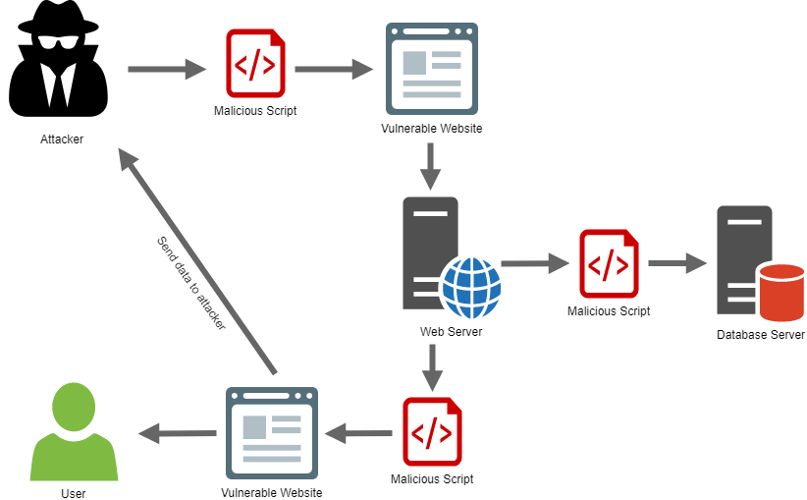
Cross-Site Scripting

Slide 3
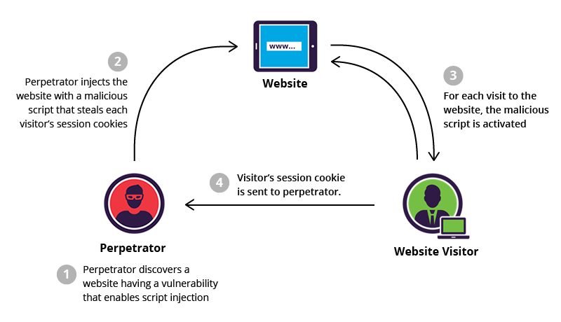
XSS Attack
XSS enables attackers to inject client-side scripts into web pages viewed by other users

Slide 4
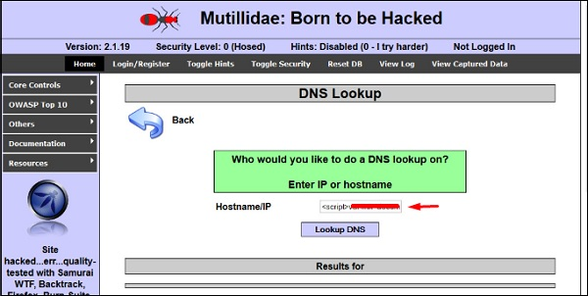
XSS Example
<script> alert(‘I am Vulnerable’) </script>

Slide 5
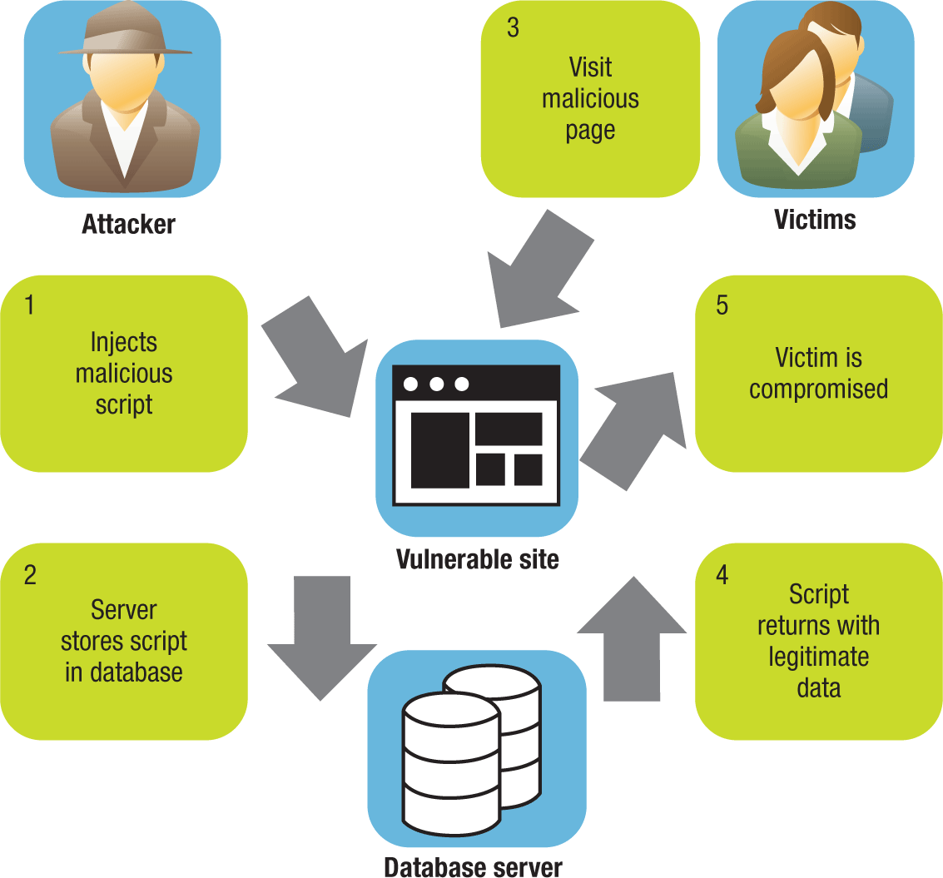
Types of XSS Attacks
Persistent XSS
Reflected XSS
DOM-based XSS

Slide 6
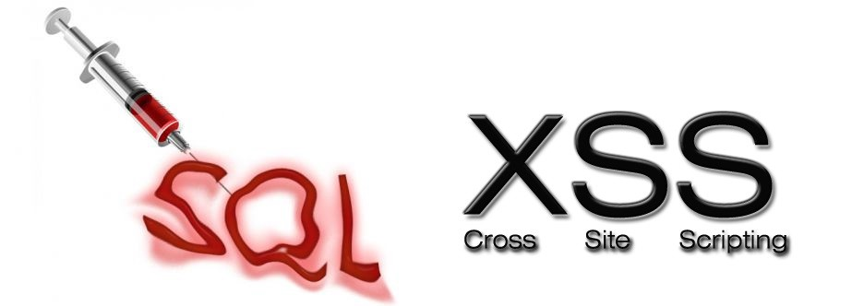
SQL Injection
SQL injection is a set of SQL commands that are placed in a URL string or in data structures in order to retrieve a response

Slide 7

SQL Injection Tools
SQLMAP
SQL NInja
JSQL Injection

Slide 8



